Slide 1
Particle Formation Use Case: 7 Experts Team#6 from Tongji University

Slide 2
1.
Summary
Brief description of our solution.

Slide 3
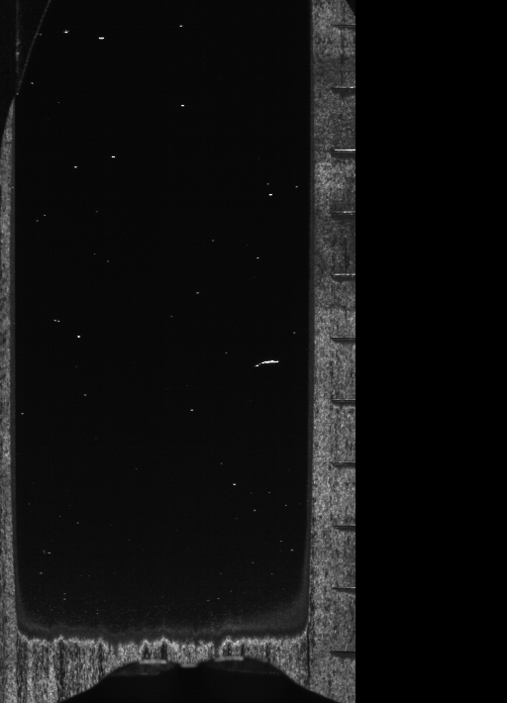

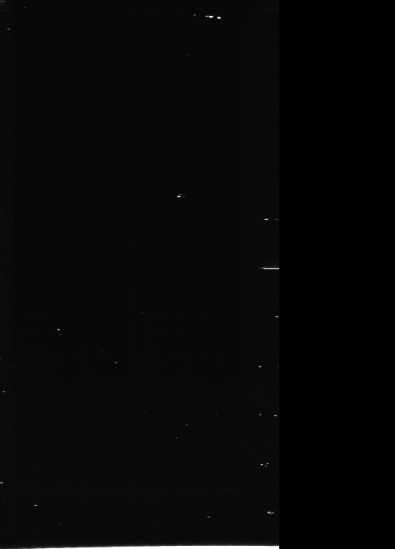
Particle Scoring by Experts
🤷🏻‍♀️🤦🏻‍♀️💁🏻🙋🏻🙍🏻🙆🏻
7+2+8+9+3+7
6
= 6

Slide 4
Automation of Judgement: Experts To AIs
Input
Score Vector of Experts
Image
🤷🏻‍♀️🤦🏻‍♀️💁🏻🙋🏻🙍🏻🙆🏻
🤖🤖🤖🤖🤖🤖
Output
Final Score

Slide 5
Our process
FIRST
Feature Extraction
SECOND
Prediction
THIRD
Combining
1# Raw image
2# Number and distribution of particles.
1# CNN * 6
2# Rule based regression
Sigmoid
function

Slide 6
2.
Exploratory Data Analysis
Let’s start to
discover the secrets of our data.

Slide 7
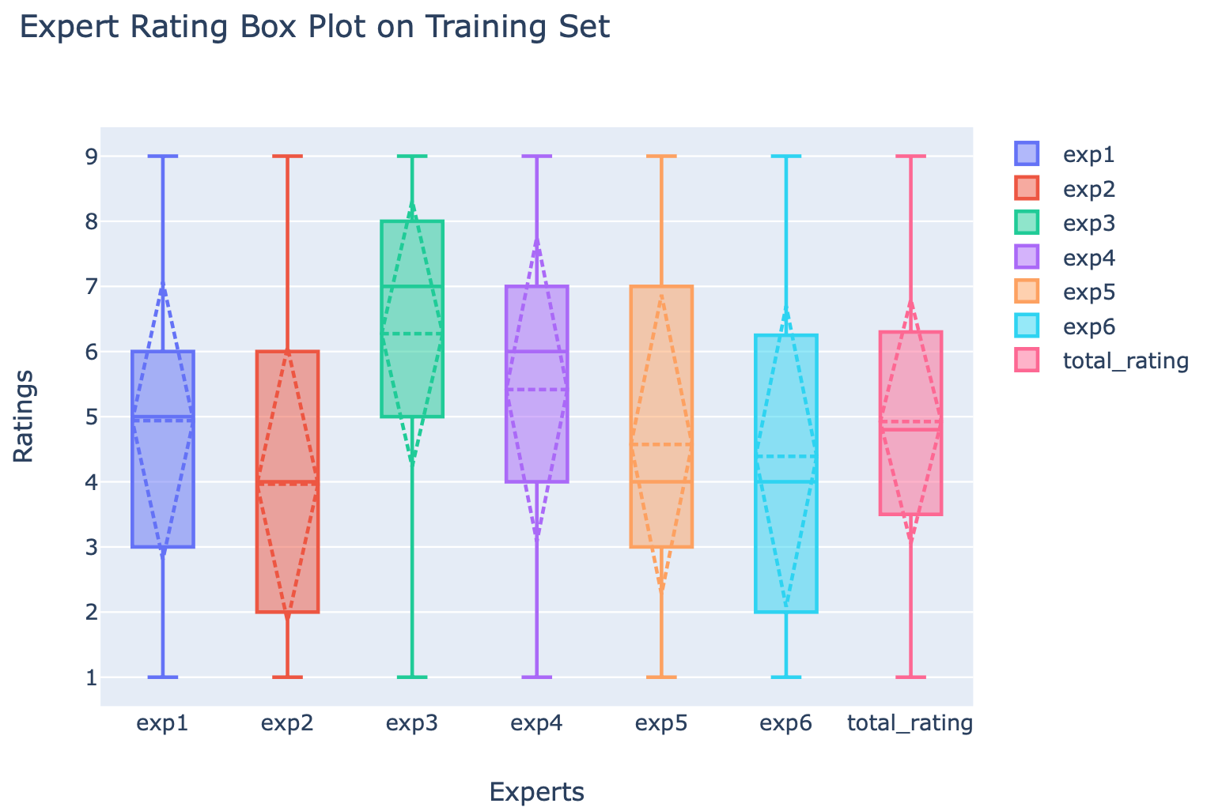
Experts’ Preference by ANOVA

Slide 8
Rating Related Factors
The number of particles(less is better)
The size of particles(smaller is better)
The distribution of particles(unknown yet)
What are particles look like?
The ISOLATED, SMALL, BRIGHT pixel blocks.

Slide 9
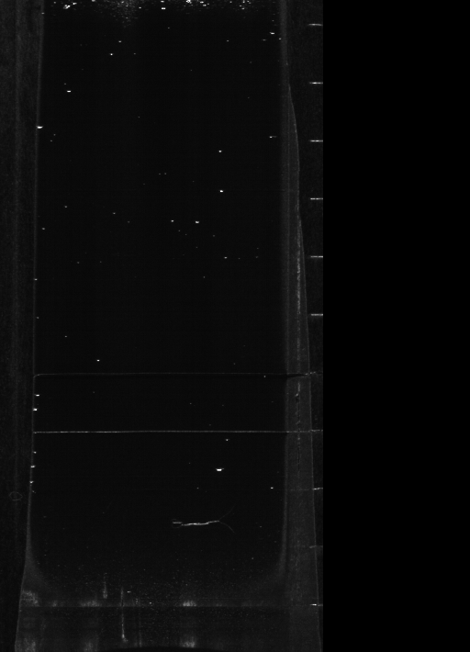
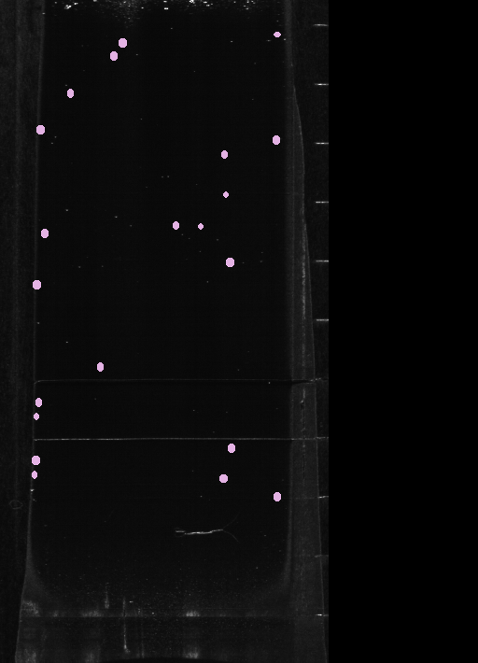
Particle Counting Pipeline
Gaussian
Blur
Segmentation
(MSER)
Removal
of Overlap
Counting

Slide 10
Number of Particles Counts
Less is better!

Slide 11
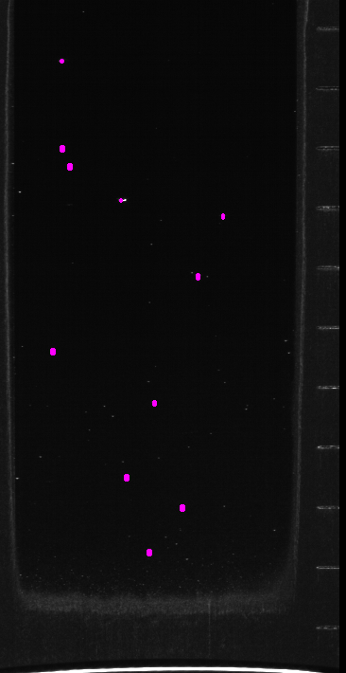
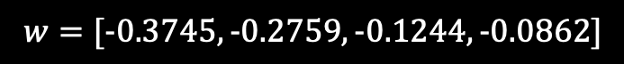
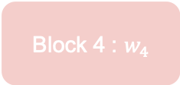
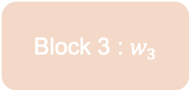
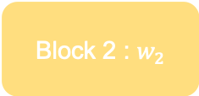
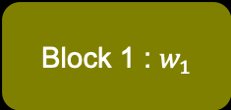
Distribution of Particles Counts
Lower is better!
Block 1 : $w_{1}$
$$w=[−0.3745, −0.2759, −0.1244, −0.0862]$$
Block 2 : $w_{2}$
We’ll talk about the details later.
Block 3 : $w_{3}$
Sigmoid Regressor
Block 4 : $w_{4}$

Slide 12
3. Model Establishment
2 main models and their combining.

Slide 13
2 Approaches
#1 Gaining Information From 6 Experts
Learn each expert’s subjective factors
Evaluate the final score by average
#2 The 7 ^{th} Expert: Rules
Particle number
Particle size
Particle distribution

Slide 14
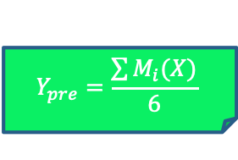
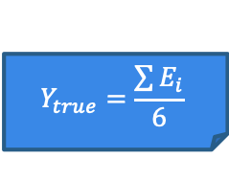
#1 Learn From Each Expert
Expert 1
Model 1
Expert 2
Model 2
. . .
. . .
Expert 6
Model 6
$$Y_{true}=\frac{\sum{E_{i}}}{6}$$
$$Y_{pre}=\frac{\sum{M_{i}(X)}}{6}$$
🤷🏻‍♀️🤦🏻‍♀️💁🏻🙋🏻🙍🏻🙆🏻
🤖🤖🤖🤖🤖🤖

Slide 15
#1 Expert to CNN
Model
Expert
CNN

Slide 16
What is the weakness of naïve CNNs?
Translation invariance is CNNs’ strength, but here it will ignore the distribution of particles

Slide 17
#1 BCNN: Block-based CNN
Building blocks to enable translational variability
BCNN
Block 1
Block 1
Block 2
Block 2
Block 3
18-Layer CNN
with Residual Block
Block 3

Slide 18
#1 End to End Pipeline of Approach 1
Average
Model 1
Expert 1
Model 2
Expert 2
18 Layer CNN
with Residual Block
Model 3
Expert 3
18 Layer CNN
with Residual Block
Model 4
Expert 4
18 Layer CNN
with Residual Block
Model 5
Expert 5
18 Layer CNN
with Residual Block
Model 6
Expert 6
18 Layer CNN
with Residual Block
BCNN

Slide 19
What is the weakness of naïve CNNs?
Translation invariance is CNNs’ strength, but here it will ignore the distribution of particles
CNNs are not good at counting

Slide 20
#2 Split the Particles into Blocks
Block 1
Block 2
Block 3
Block 4

Slide 21
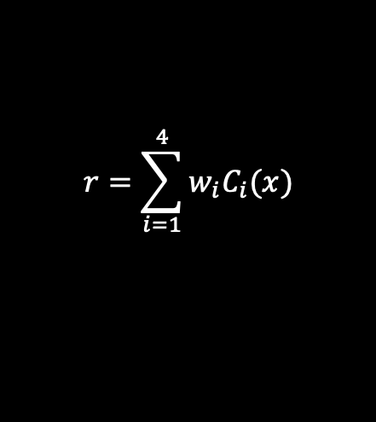
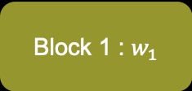
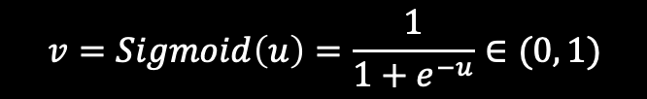

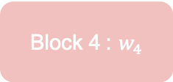

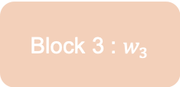
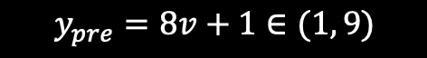
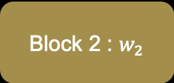
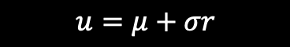
#2 Sigmoid Regressor
We used stochastic gradient descent(SGD) to get its optimal parameters!
$C_{i}(x)$: The number of particles of
Block 1 : $w_{1}$
$$r=\sum_{i=1}^{4}{w_{i}C_{i}(x)}$$
$μ$: Mean value of $y_{true}$
$σ$: Variance of $y_{true}$
Block 2 : $w_{2}$
$$u=μ+σr$$
Block 3 : $w_{3}$
$$v=Sigmoid\left(u\right)=\frac{1}{1+e^{−u}}∈(0, 1)$$
$$y_{pre}=8v+1∈(1, 9)$$
Block 4 : $w_{4}$
$$w=[−0.3745, −0.2759, −0.1244, −0.0862]$$
Upper particles contribute more to LOW QUALITY.

Slide 22
Model Combining
Since we have 6+1 = 7 experts, we need to “connect the experts” and make a combination.
Model 1
. . .
Combining
Model 6
Model 7

Slide 23
Details of Combining
We used stochastic gradient descent(SGD) to get the parameters!
CNN 1
. . .
AVG
1+8×Sigmoid(wx+b)
CNN 6
Sigmoid Regressor 7

Slide 24
4. Conclusions
Highlights and results.

Slide 25
End to End CNN
Particle Extractor
Block Based Methods
Powerful image feature extraction
Highlights
Add the information of particle numbers, as CNN is not good counting
Utilize the distribution information of particles
Model Combining
Make the evaluation more objective

Slide 26
84.960%
Our Final R-square Score

Slide 27
5. Business Integration
Business value of our solution.

Slide 28
Business Value
Efficient
Economic
Objective

Slide 29
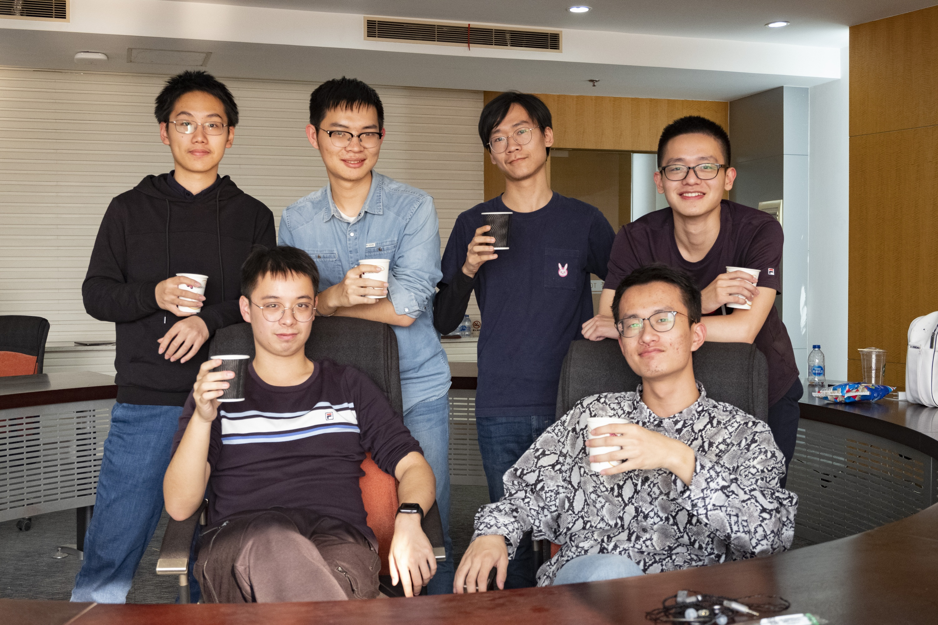
THANKS!
Team#6 from Tongji University.
Members
Jiawei Liu | Xin Wen | Renfeng Peng
Kun Liu | Ziming Cheng | Haoran Zhang

